Slide 1



E-LEARNING SYSTEM
TEAM 4
MENTOR
SANJEEV GONE
The project aims to develop a user-friendly E-learning web application, offering flexible, remote education for students, professionals, and job seekers.
TEAM MEMBERS
ANIKET BARUA
OM KRISHNA GUPTA
NILESH WALE
HARSHADA PATIL

Slide 2




Introduction
The E-Learning System is a web-based application designed to provide seamless access to online education for students and professionals.
Built using a robust tech stack comprising Angular for the frontend, Spring Boot for the backend, and MySQL for database management, this system facilitates user authentication, role-specific functionalities and course management.
The platform has role-based access control, it ensures tailored user experiences for students, professors and administrators.
The system emphasizes scalability, secure data handling, and a user-friendly interface, aiming to meet the growing demand for flexible and efficient e-learning solutions.
LOGIN

Slide 3


Project overview
USER MODE
Course Exploration: Users can browse, search, and explore available courses.
Enrollment & Learning: Users can enroll in courses and track their progress.
Profile Management: Users can edit their personal details and view their enrolled courses.
Wishlist & Favorites: Users can save courses to their wishlist and mark favorites.
User Dashboard: Displays key statistics such as total enrolled courses, most liked courses, and progress.
USER FEATURES

Slide 4

Project overview
PROFESSOR MODE
Course Creation: Professors can create and manage courses, adding chapters and learning materials.
Enrollment & Learning: Professors can also enroll in courses to continue their education and mark favorites.
Profile Management: Professors can update their professional details and check their approval status.
Professor Dashboard: Displays key metrics like total learners, total courses created, and most liked content.
PROFESSOR FEATURES

Slide 5

Project overview
ADMIN MODE
User & Professor Management: Admins can manage user and professor accounts, including registration approval and account management.
Course Management: Admins can add, edit, or delete courses and chapters.
Dashboard & Analytics: Admins can access a dashboard that provides key system metrics like total users, courses, and engagement statistics.
Approval Workflow: Admins can approve or reject professor applications for creating courses.
Role-based Access: Admins control permissions, ensuring appropriate access for each user role.
ADMIN FEATURES

Slide 6

Seamless Learning: Enable users to easily explore, enroll in, and track courses, with personalized dashboards.
OBJECTIVES
Efficient Content Management: Allow professors to create and manage courses and chapters, engaging with learners effectively.
Streamlined Administration: Provide admins with tools for user, professor, and course management, alongside reporting and analytics.
Role-Based Access: Implement tailored access for users, professors, and admins to ensure security and proper functionality.
Continuous Learning: Promote professional development by allowing professors to enroll in courses and fostering lifelong learning for users.
Data Insights: Provide key metrics to guide decision-making for admins, professors, and users.
Scalability: Design a flexible, scalable system to handle growth in users, courses, and content.

Slide 7


MILESTONES
COURSES
Milestone 1
MILESTONE 2
The focus is on implementing user authentication and registration, ensuring users can register, log in, and be redirected to their respective dashboards based on their roles. Profile sections with pictures and course details are displayed. The email verification and password reset features are also integrated.
The primary objective is to develop course availability management is designed, including the creation of a backend to manage course information and feedback, alongside a recommendation system for selecting courses based on feedback. The frontend is fully implemented with Angular, ensuring proper form validations.
Milestone 3
Milestone 4
This phase includes designing the course information management system, enabling users to view and manage course details. The backend functionality supports course viewing, updates, and prevents conflicts. A search option for courses and milestones is implemented. Additionally, a video content maintenance system with QA is developed to track progress through each course milestone.
The focus is on managing course details, including updating user profiles with the courses and milestones. The notification system is integrated, with automatic email/SMS notifications for new appointments, new bookings, and cancellations. Finally, the admin dashboard is developed, allowing administrators to manage users and courses effectively.

Slide 8



Hardware Requirements
REQUIREMENT SPECIFICATION
Quad-core processor
8 GB RAM
100 GB SSD
stable internet (1 Mbps+).
Browsers (Chrome, Firefox, Safari)
Software Requirements
Angular
Spring Boot
Java 21
MySQL
IntelliJ IDEA/VSCode
Git
Maven/Gradle
Postman
F

Slide 9

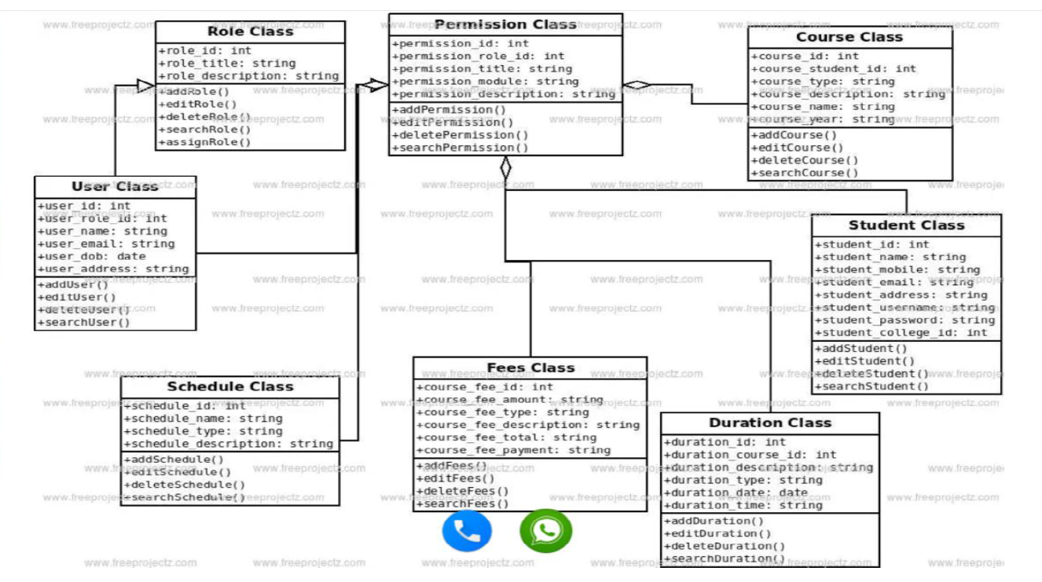
CLASS DIAGRAM

Slide 10
KEY ACHIEVEMENTS AND DELIVERABLES
Key Deliverables:
Fully Functional Modules:
User Authentication and Registration
Course Availability and Feedback Management
Course Information
Admin Dashboard
Database Design: Comprehensive schemas for users, courses, schedules, and feedback.
Front-End Interface: Responsive UI built with Angular, including form validations and dashboards.
Back-End Functionality: Robust Spring Boot APIs for seamless system operations.
.
Key Achievements:
Successfully implemented secure user authentication and role-based dashboards for admins, professors and students.
Developed a dynamic course management system with course recommendations.
Integrated automated email/SMS notifications for user registration.
Delivered an intuitive admin dashboard for managing users, courses, and system settings.

Slide 11


CHALLENGES AND SOLUTIONS
Challenges
Ensuring secure login, role-based access, and data protection.
Handling increased user load and growing data without affecting performance.
Designing a user-friendly and responsive interface across different devices.
Managing complex relationships between courses, students, and schedules.
Solutions
Implemented Spring Security with encryption, role-based access control, and secure password storage.
Used a scalable MySQL database with optimized queries and deployed the backend on a high-performance server.
Built a responsive Angular-based UI with consistent navigation, form validations, and graphical course progress representation.
Designed normalized SQL schemas and implemented effective indexing for faster data retrieval.

Slide 12


RESULTS
E-Learning System
Enhanced User Experience: Delivered a responsive and user-friendly web interface, enabling seamless navigation for students and administrators.
Efficient Course Management: Successfully implemented a robust course availability and booking.
Comprehensive Admin Control: Developed an admin dashboard to manage users, courses, and system configurations effortlessly.
Scalable System Architecture: Designed a scalable backend capable of handling high user traffic and data volume without performance degradation.
Improved Engagement: Notifications and progress tracking fostered higher engagement and timely course completion rates.
Secure and Reliable Platform: Ensured data security and system reliability through robust authentication and error-handling mechanisms.

Slide 13
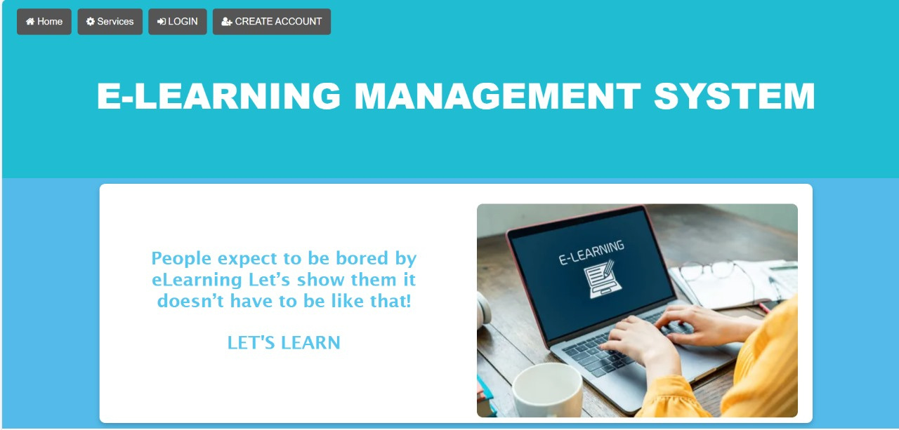
LANDING PAGE

Slide 14
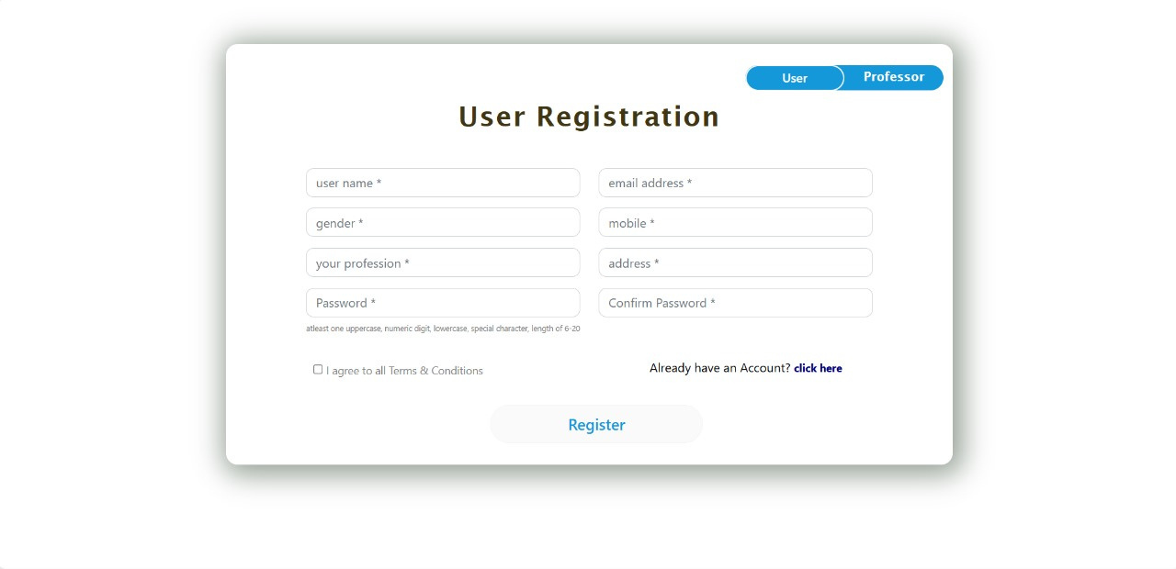
REGISTRATION PAGE

Slide 15
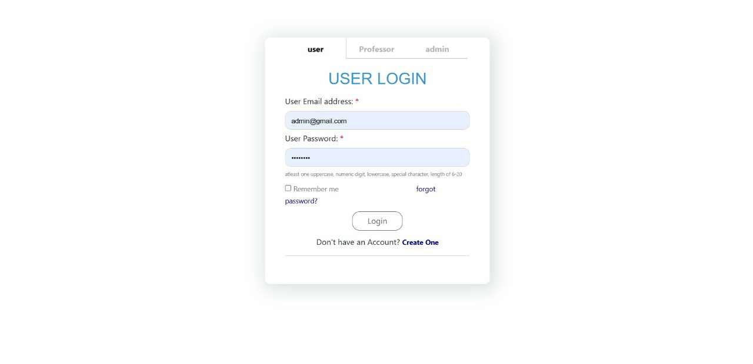

LOGIN PAGE
Login feature for all (user, professor, admin)

Slide 16
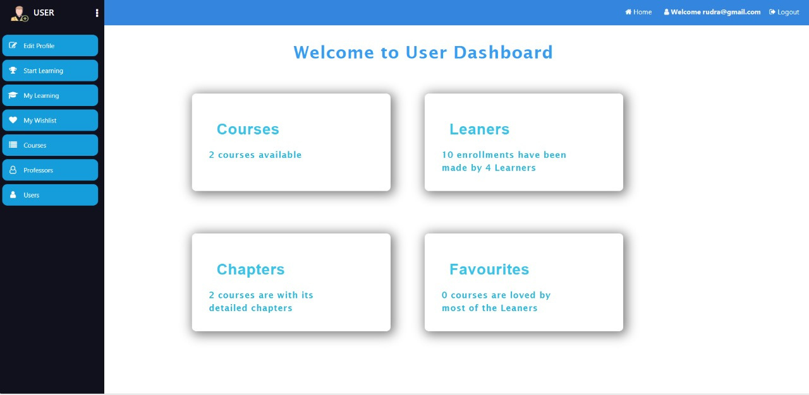
USER DASHBOARD

Slide 17
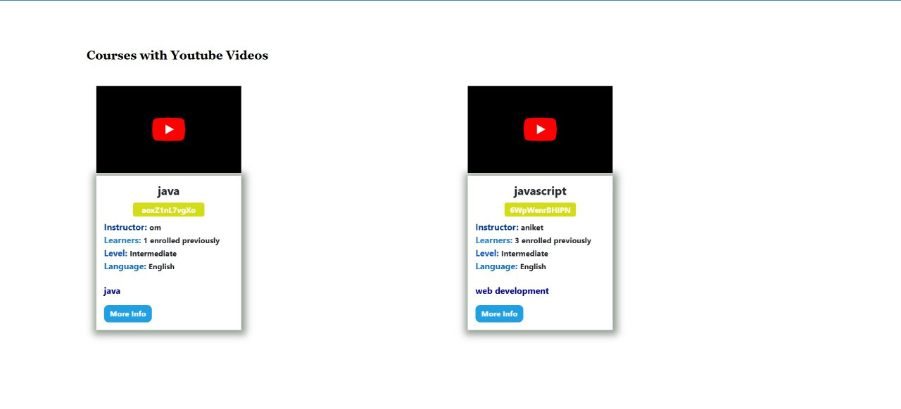
COURSES AVAILABLE

Slide 18
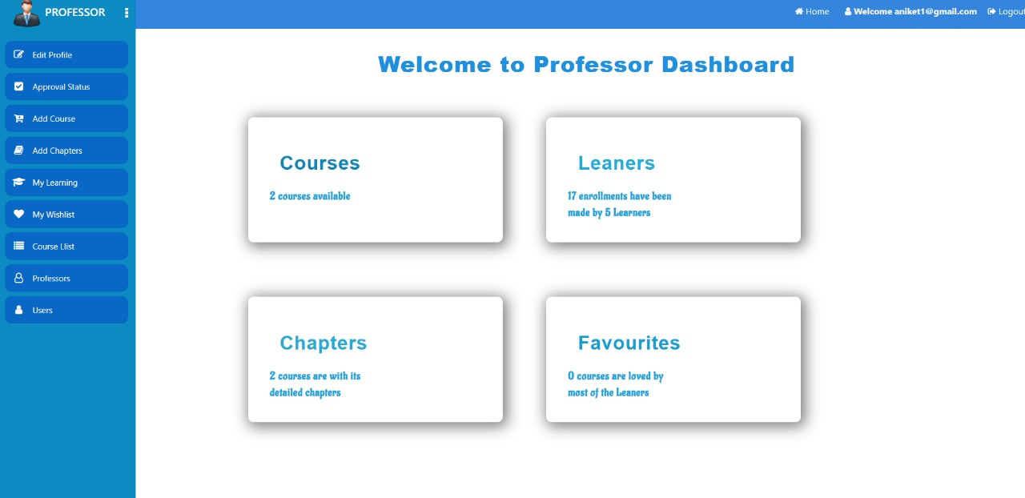
PROFESSOR DASHBOARD
Features to add courses and chapters

Slide 19
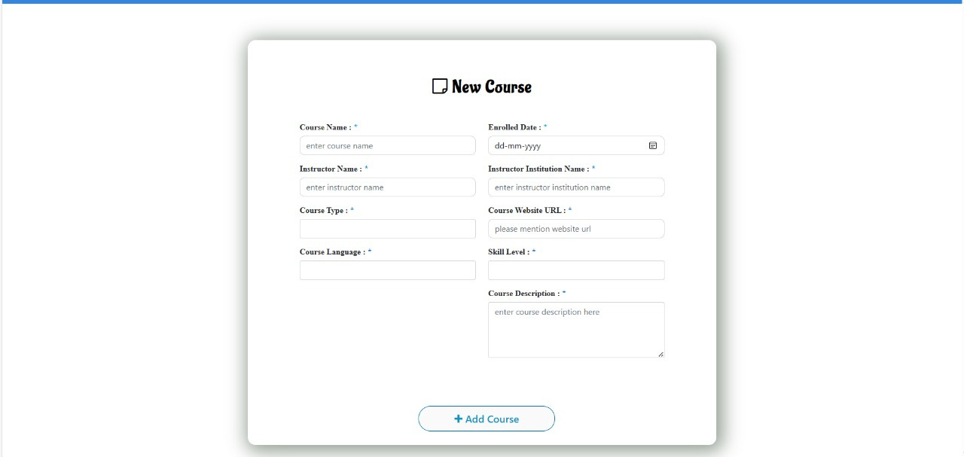
ADDING NEW COURSES

Slide 20
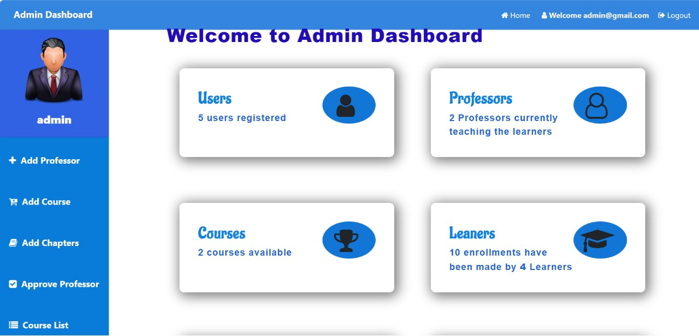
ADMIN DASHBOARD

Slide 21


Conclusion
The E-Learning System successfully addresses the growing demand for flexible and accessible online education by providing a secure, scalable, and user-friendly platform. Key features like role-based dashboards and course recommendations, enhance the overall learning experience for students and streamline course management for administrators.
By integrating advanced technologies like Angular for a responsive interface and Spring Boot for a robust backend, the system ensures high performance and reliability. With its ability to handle real-time interactions and personalized user engagement, the E-Learning System stands as a significant contribution to modern digital education solutions.
LOGOUT

Slide 22
Thank You

